Slide 1
Understanding the increase of COVID-19 Recovery, Confirmed and Death Cases and future prediction in WORLD
Machine Learning Project Presentation
Group members:
Tejasvita Pandey
Laxmi Vishwakarma
Chetan Sharma
Anuj Soni

Slide 2
Introduction and Overview
In this project, we have proposed methods for predicting Covid-19 in patients using machine learning techniques. The machine learning techniques that were used include Time series forecasting. We hope that our forecasts will be a useful tool for governments and individuals towards making decisions and taking the appropriate actions to contain the spreading of the virus to the degree possible. Regardless of what one’s beliefs are, we believe that their associated uncertainty can and should be an integral part of the decision-making process, especially in high risk cases. Apart from the significant public health concerns, the dangers imposed on global supply chains and the economy as a whole are also considerable. Risk-averse people can focus on the worst-case-scenarios and act accordingly. Deciding to discard any formal, statistical forecasts and acting conservatively, still implies an underlying forecasting process, even if this process is not formalised.

Slide 3
Objectives
Our goal is to analyze the covid-19 data in programming languages Python using Prediction algorithms based on time series forecasting; and how the governments of different countries can use that prediction for making effective decisions and future strategies. The outcomes should be in graphical form so that anyone can easily understand the trends. Assuming that the data used is reliable and that the future will continue to follow the past pattern of the disease, our forecasts suggest a continuing increase in the confirmed, death and recovery COVID-19 cases with sizable associated uncertainty.

Slide 4
Methodology
The methodology of our project is based on Time Series Forecasting. Time Series is a group of data points that are collected at a constant interval of time. These are analyzed to determine the long term trend so as to forecast the future or perform some other form of analysis.There are many ways to implement time series, for this project we used FbProphet particularly.
The code architecture is divided into two parts:
1.Data Analysis
2.Data Prediction(covered in outcomes part)

Slide 5
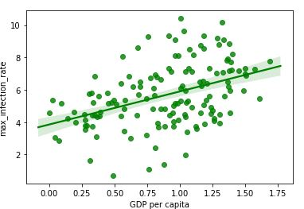
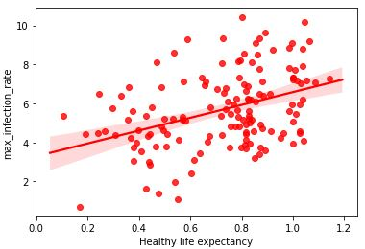
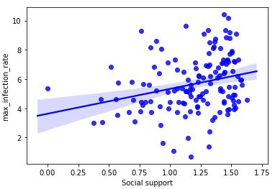
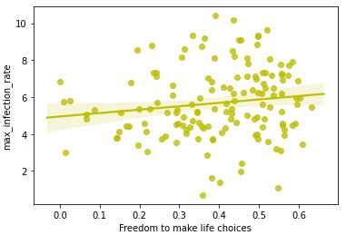
1.Confirmed Cases Analysis (region=china)

Slide 6
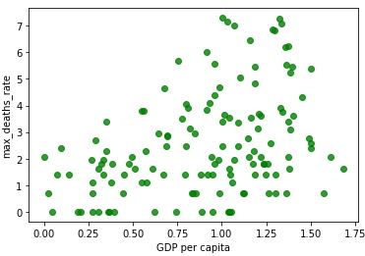
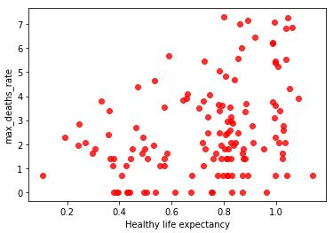
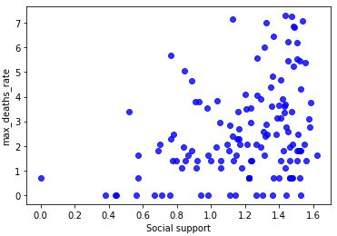
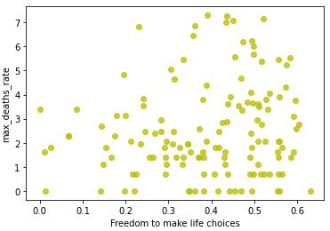
2. Death Cases Analysis (region=china)

Slide 7
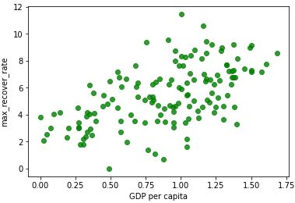
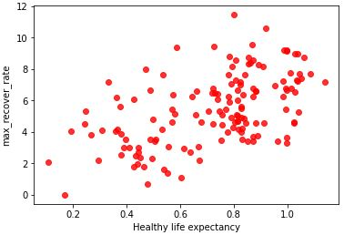
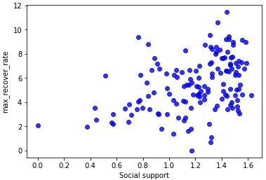
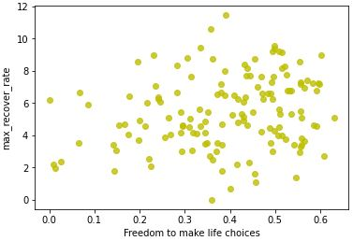
3.Recovered Cases Analysis(region=china)

Slide 8
Outcomes
These results were obtained by applying prophet statistic forecasting. The forecast method will allot each row a predicted value which it means “yhat”. If you pass in historical dates, it'll provide an in-sample fit. The forecast object here could be a new dataframe that has a column “yhat” with the forecast, furthermore as columns for components and uncertainty intervals “yhat-lower, yhat-upper”.
Note: The dataset we used is recorded up to date(6june2020)
Prediction we generated is about 1 year forecast(World-wide)

Slide 9
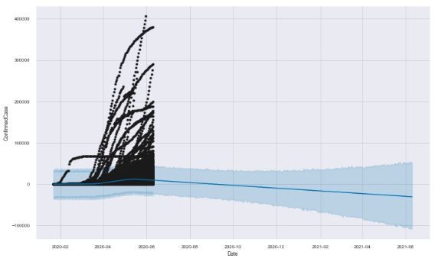
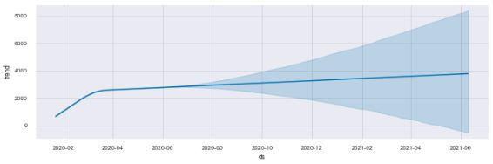
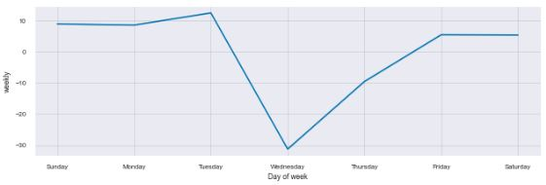
1.Confirmed Cases Prediction

Slide 10
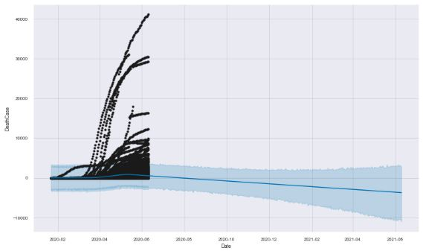
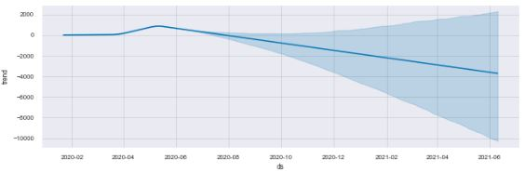
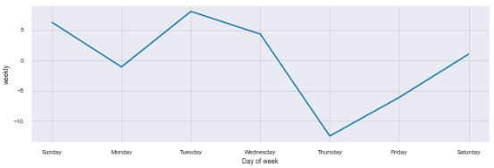
2. Death Cases Prediction

Slide 11
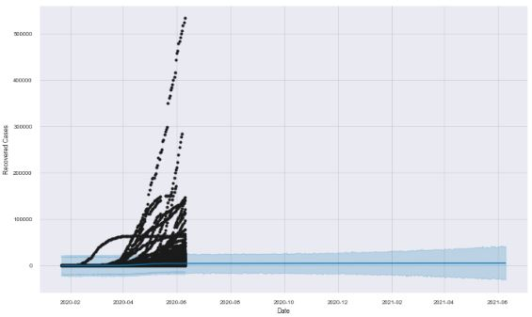
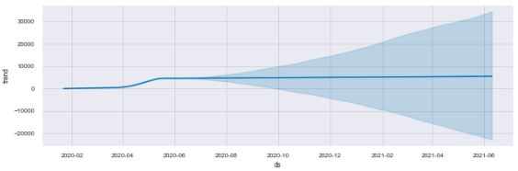
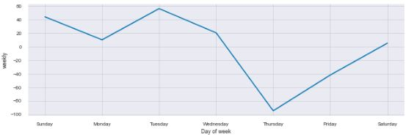
3.Recovered Cases Prediction

Slide 12
Conclusion
Forecasting the spread of confirmed cases moreover as analysis of the number of deaths and recoveries. Forecasting however, requires sufficient historical data. At the same time, no forecasting is precise because the long run repeats itself hardly ever within the same course of action as the past.Moreover, forecasts are influenced by the reliability of the information, vested interests, and what variables are being predicted. Also, psychological factors play a giant role in how people perceive and react to the danger from the disease and thus the fear that it should affect them personally. This manifesto introduces an objective approach to predicting the continuation of the COVID-19 employing a straightforward, but powerful method to do so. The risks are removed from symmetric as underestimating its spread style of an outbreak and not doing enough to contain it's far more severe than overspending and being over careful when it'll not be needed. This describes the timeline of a live forecasting exercise with massive potential implications for planning and decision making and provides objective forecasts for the confirmed, death and recovered cases of COVID-19.

Slide 13
Thank You
Project Code:- https://github.com/CSSEGISandData/COVID-19
Dataset link:-https://github.com/Covid-19

